Slide 1


S.A.V.A.S.
Electricity bill generating Application

Slide 2

Electricity bill generation Application
Team Members
Aryan Rajaputra
Aryan M
Anwesh
Shiny
Shaik Adil

Slide 3
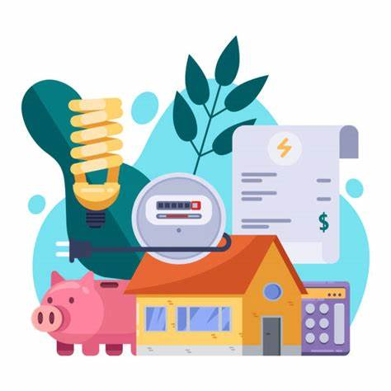
Electricity Bill Generating Application - Working
S.A.V.A.S. is an Electricity bill generation Application that allows the user to generate electricity bill for the electricity consumed. The user is able to register on the application by entering username, first name, last name, password, address etc. The user is able to login into the application by entering username and password. The user enters all the details in the meter details module. The user details will be fetched from the login page. The bill details data will be fetched from customer details and meter details module.

Slide 4
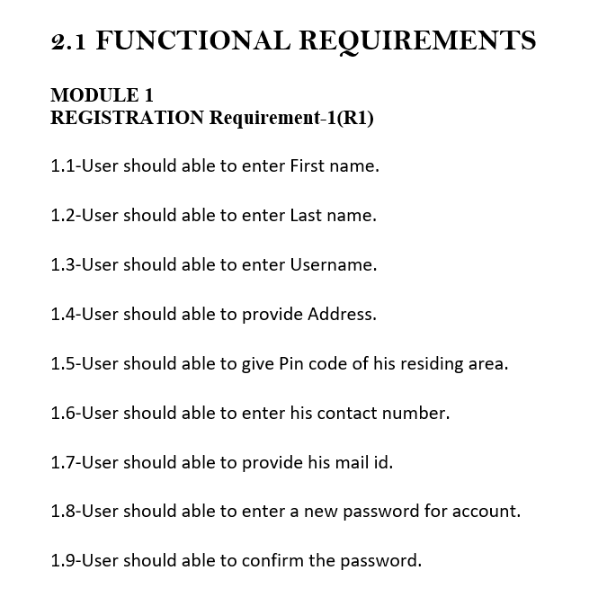
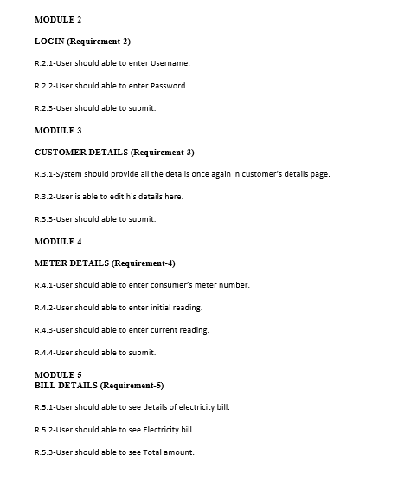

SOFTWARE REQUIREMENT SPECIFICATION (SRS DOCUMENT)
SRS Document
SAVAS Electricity
Billing Software.docx

Slide 5
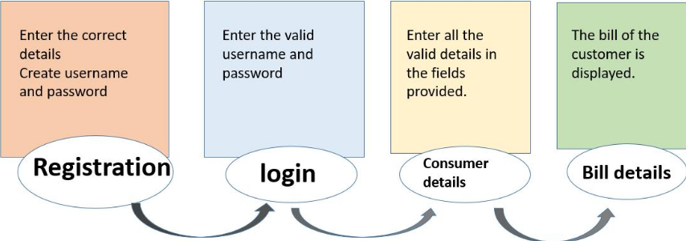

Slide 6
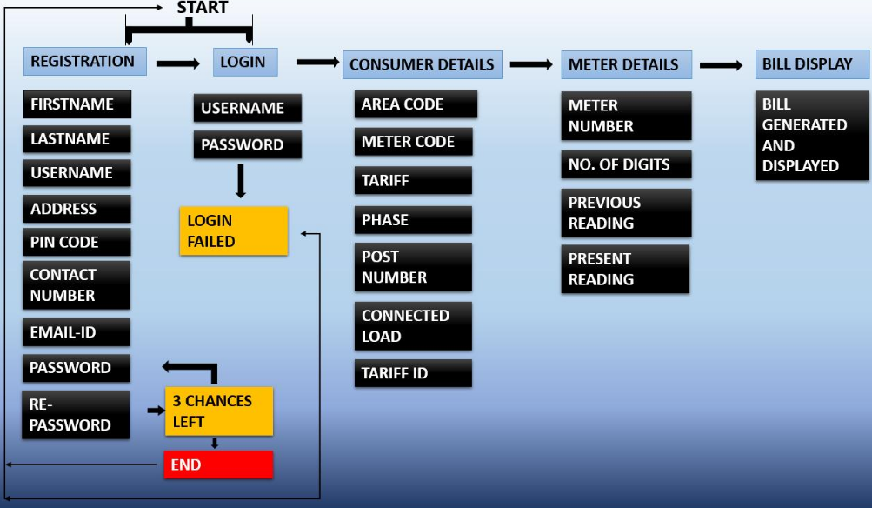

Slide 7
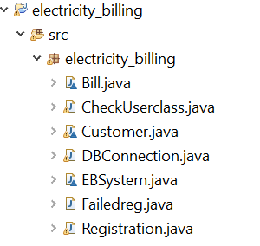
THE SOURCE CODE INCLUDES THE FOLLOWING CLASSES
Registration.java (Main Class)
Customer.java
EBSystem.java
Bill.java
Failedreg.java
DBConnection.java
CheckUserclass.java

Slide 8
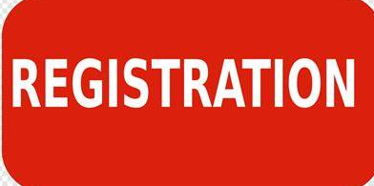
Registration.java
It is the main class that you need to run the program from this class.
It contains the registration and login module which allows the user to choose.
To Register Press 1. To Login Press 2.
If user enters any other key apart from 1 or 2 an error message will be displayed and the program will be terminated.

Slide 9

Customer.java
After registration class user will have to either register or login according to what the user chose.
User will have to enter registration details.
User will have to enter login details.
User will have to enter consumer details.
User will have to enter meter details.

Slide 10

EBSystem.java
In this class all the calculation is done.
The details user enters in the Customer.java class will be calculated in this class.
It is a subclass of customer class.

Slide 11
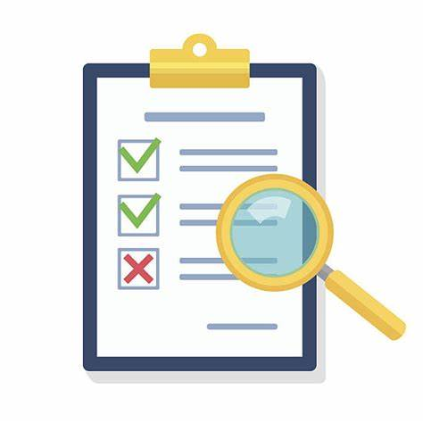
Bill.java
It is a subclass of EBSystem class.
In this class all the details will be displayed
The data will be retrieved from registration, login, consumer details and meter details will be printed in this class.

Slide 12
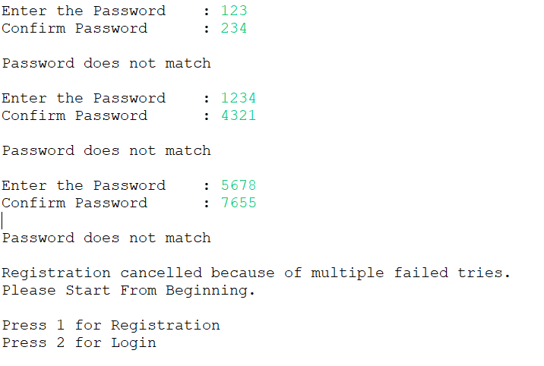
Failedreg.java
This is a subclass of Registration class.
This is used when the user enters invalid details in the fields like password and re-password while registering and invalid username and password.
For the registration (password & re-password) three chances are given, if the user enters invalid input three times then program will terminate and start from beginning.

Slide 13

DBConnection.java
This class acts as the linking between Oracle Database and java.
In this class all the JARs have been imported and a connection has been established.

Slide 14

Checkuserclass.java
In this class the First name, last name, address, username, password and re-password that the user enters during registration will be stored in database.
In this class the details entered in java will be stored in oracle database.
The entered details can be used as a reference for login.

Slide 15
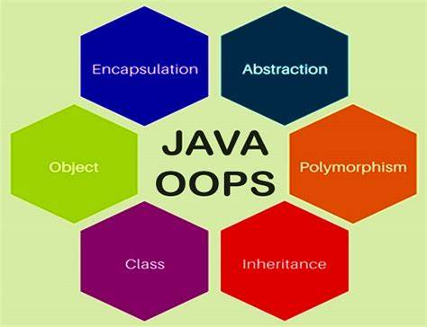
Concepts Implemented in program
Classes/Objects
Collections
Inheritance
Exception Handling
JDBC

Slide 16
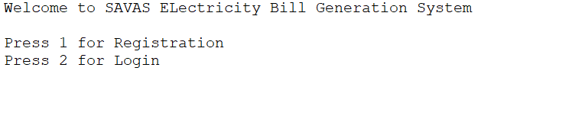
Homepage
The homepage consists of two modules
Registration
Login

Slide 17
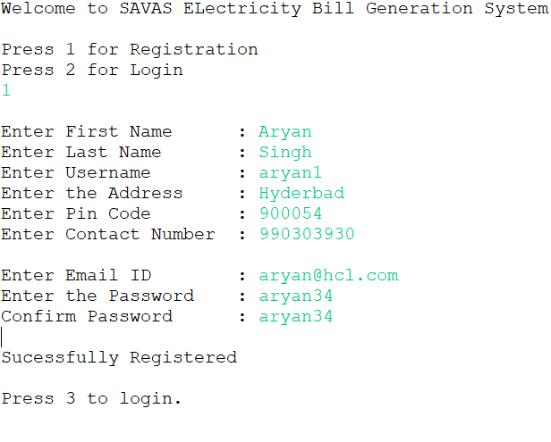
Registration Module
All the fields should be filled.
Password and Confirm password should be same in order to move forward.

Slide 18
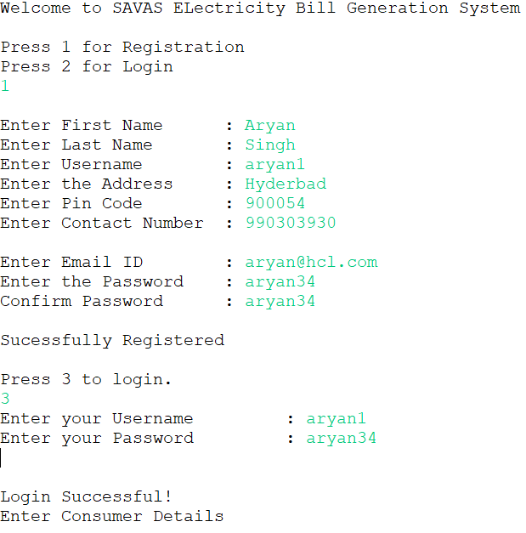
Login Module
The username and password entered should be valid otherwise program will be terminated.

Slide 19
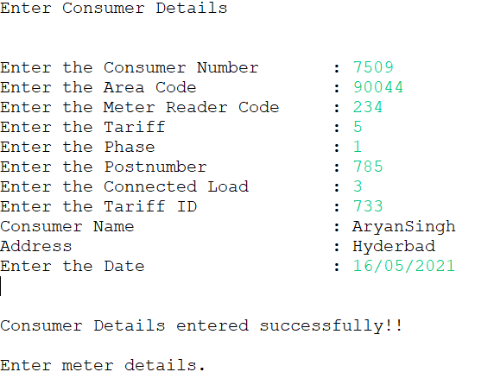
Consumer Details
The user has to enter consumer details and fields like name and address’s data will be fetched from Registration class.

Slide 20
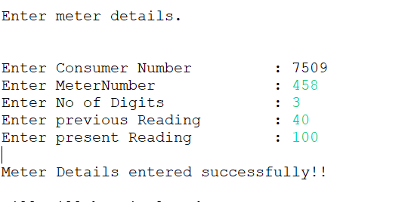
Meter Details
The user has to enter the meter details. Data like consumer number will be fetched from previous class.

Slide 21
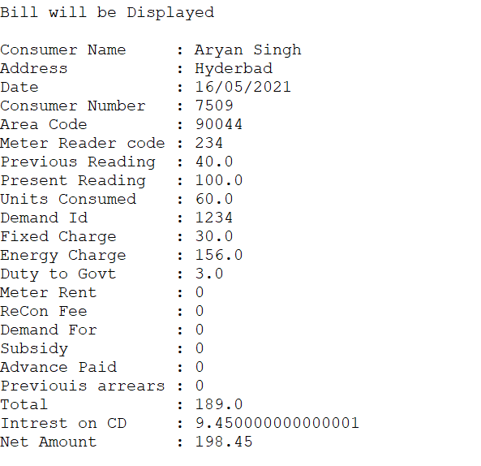
Bill Details
All the previously entered data will be printed in this class and after the final bill is executed, program will be terminated.

Slide 22
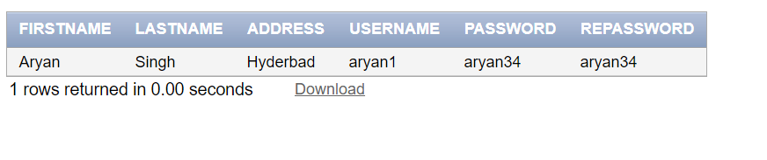
Oracle Database
The data entered by the user during registration will be stored in the database using JDBC.

Slide 23
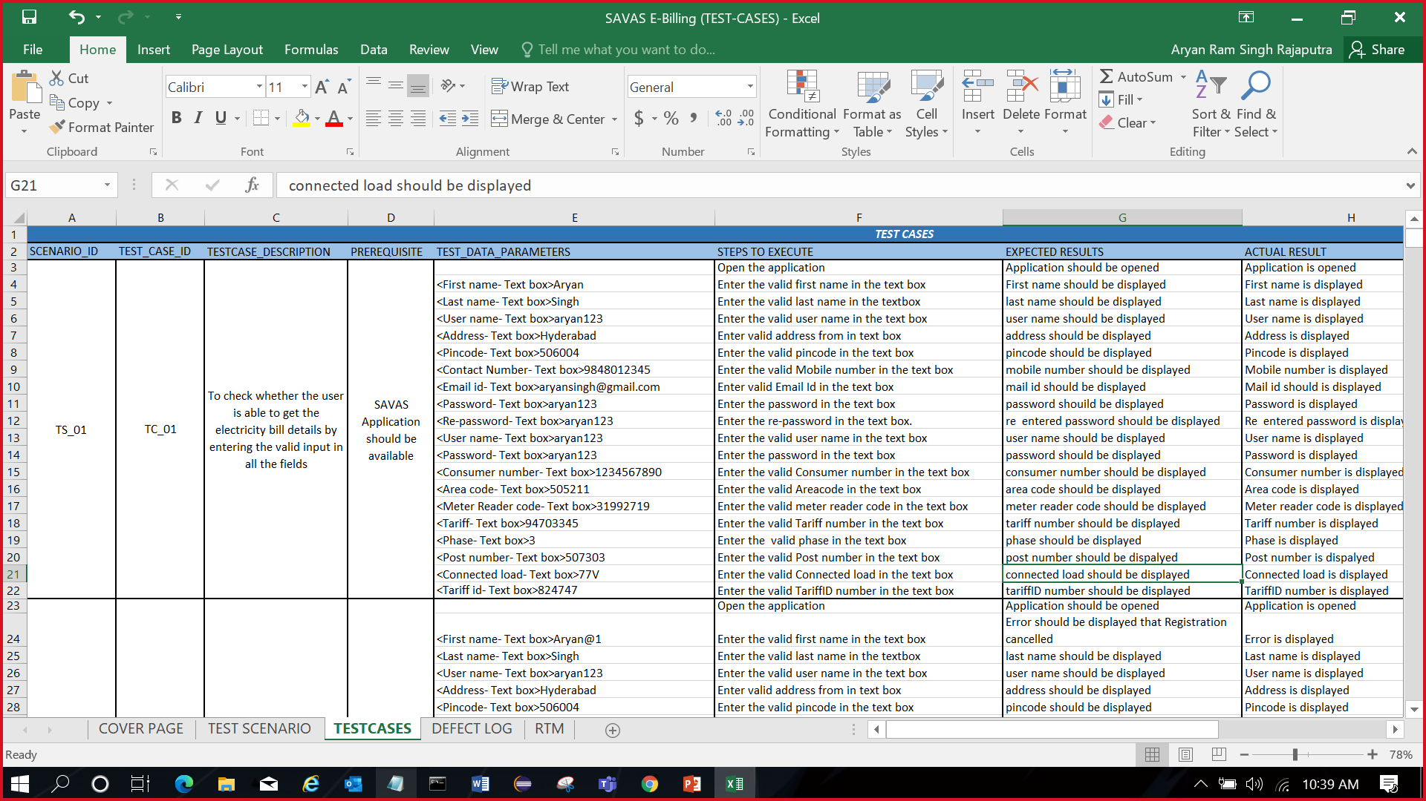
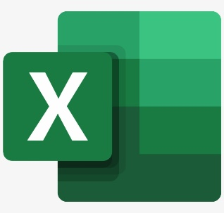
TESTING DELIVERABLES
Test Case
Document
SAVAS E-Billing
(TEST-CASES).xlsx

Slide 24

DEMO HOSPITAL MANAGEMENT APPLICATION

Slide 25

Smart Hospital Web Application
Smart Hospital is an online demo web site for online hospital related procedures. It contains all basic features that a patient gets while handling online hospital website.
To login into the website, a default Login ID and Password has been provided.
The demo website contains various fields, checkboxes, drop-down, etc. that can be tested.
LINK : Smart Hospital : Hospital Management System (smart-hospital.in)

Slide 26
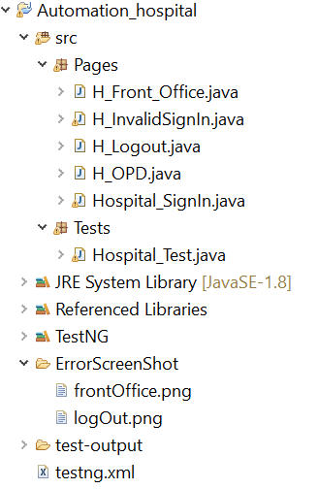

Automation Testing Classes

Slide 27


Dependencies Used in Automation
import org.junit
Used for file handling, Scanner, Time unit and exception Handling.
org.seleniumhq.selenium
Used for handling Web Driver, Drivers for edge, firefox, and chrome, Alert Handling, Web elements, Cache Lookup, Findby, How, Pagefactory and BY.
Org.testng
Used for annotations (like @Before, @Test, @After, @BeforeClass, @AfterClass, @Parameters), Assertions.

Slide 28
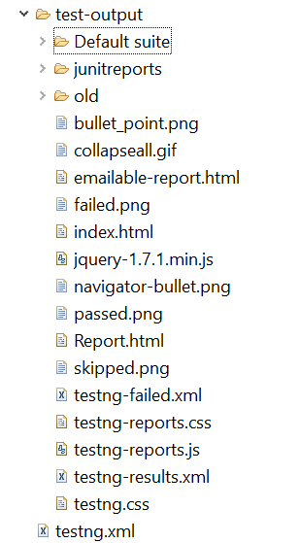
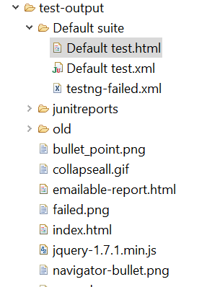
Testing Output

Slide 29
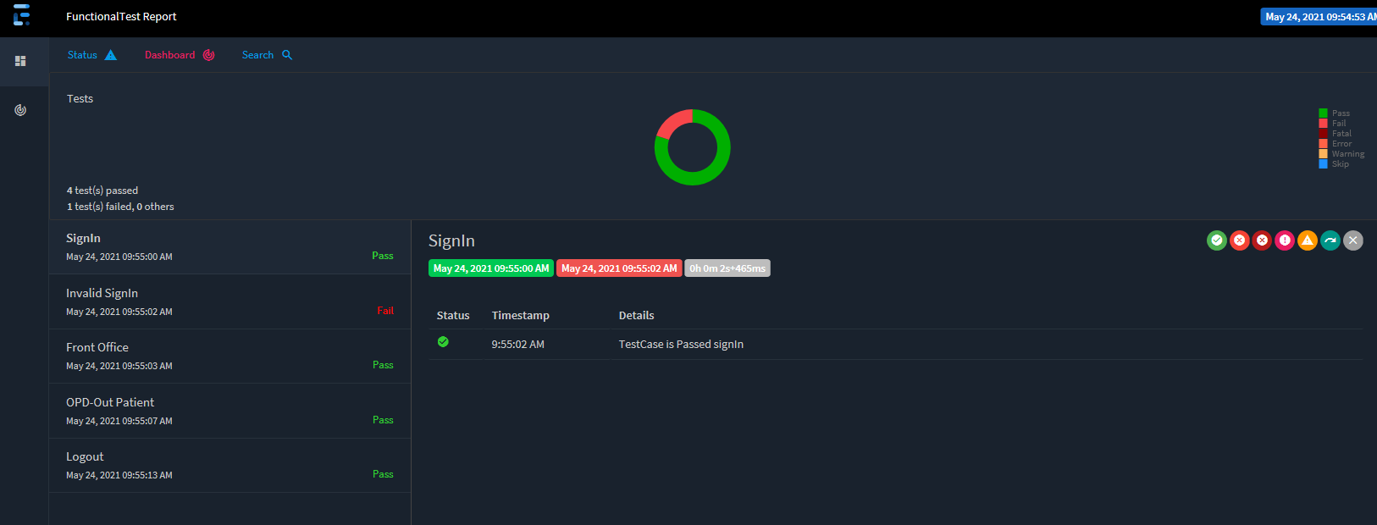
HTML Extent Report

Slide 30
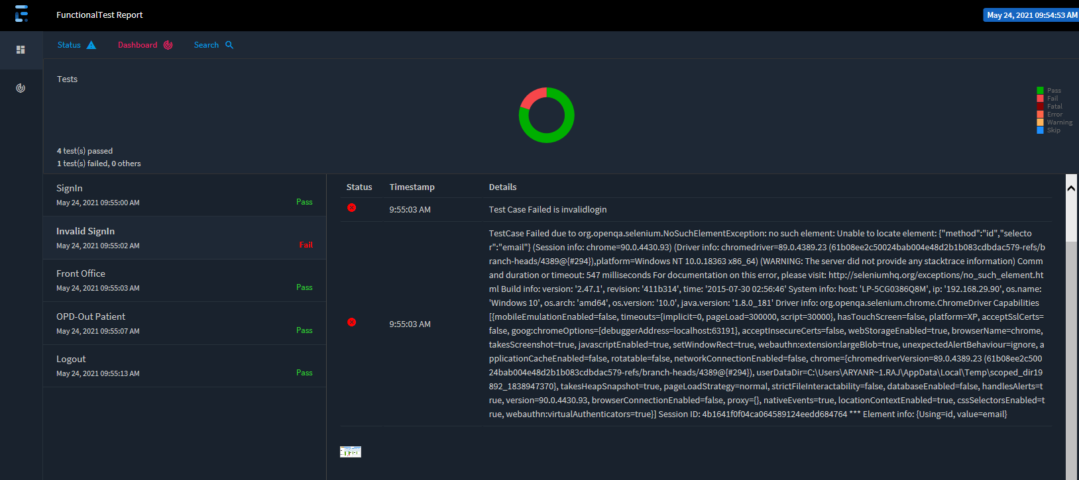
Extent Report (Contd.)

Slide 31
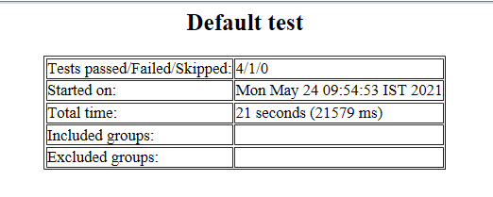
Default Test

Slide 32
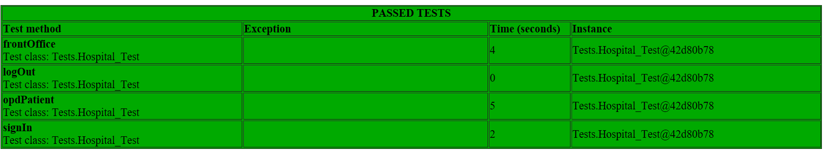
Default Test (Contd.)

Slide 33
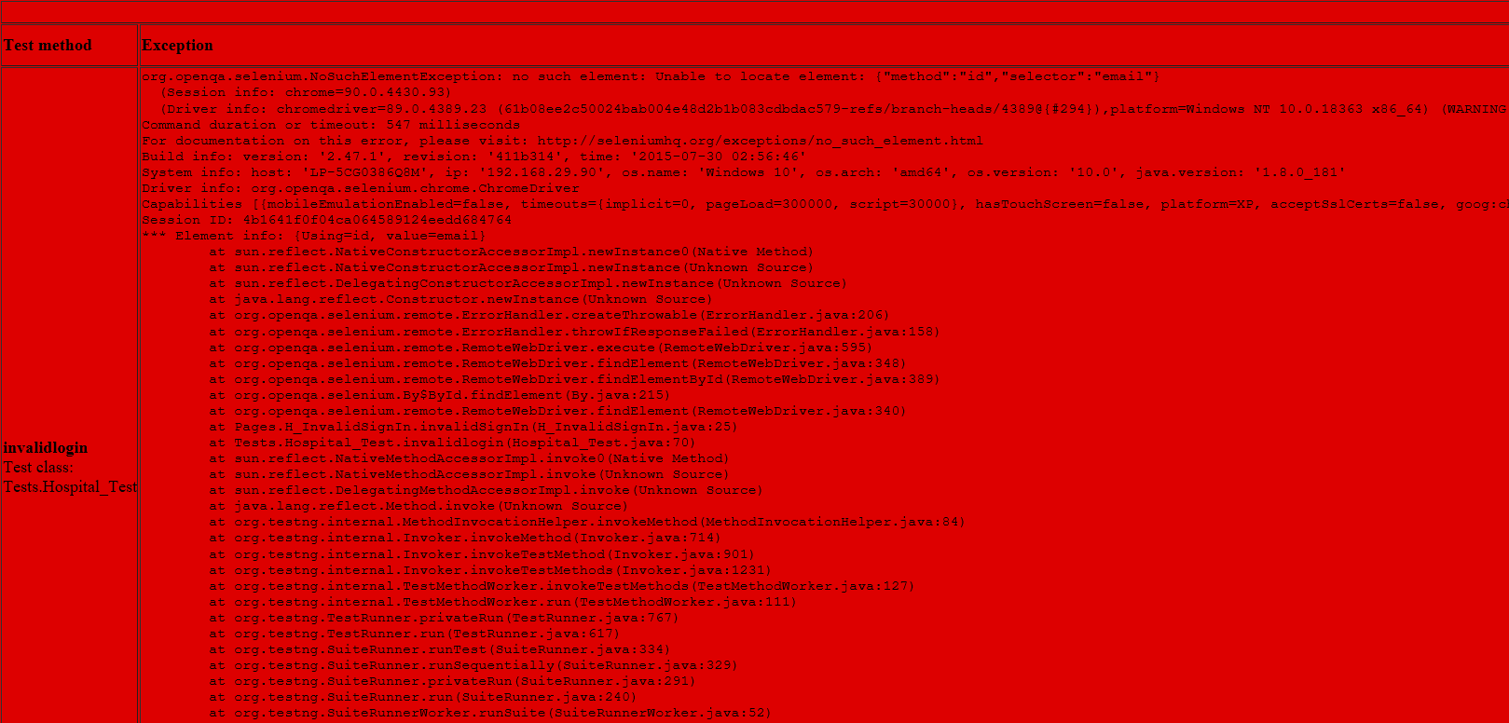
Default Test (Contd.)

Slide 34

GIT-HUB
Aryan-Singh11/S.A.V.A.S. (github.com)

Slide 35


